Slide 1

COURSE: ECONOMICS (MINOR)
PAPER NAME – ELEMENTARY ECONOMICS
TOPIC –MARSHALLIAN APPROACH TO UTILITY
YEAR- FIRST SEMESTER-1 SESSION -2023-2024
DATE OF LECTURE: 16/09/2023
PREPARED BY
DR. KAMALIKA CHAKRABORTY
ASSISTANT PROFESSOR (DEPARTMENT OF ECONOMICS)
KHATRA ADIBASI MAHAVIDYALAYA, BANKURA, WEST BENGAL

Slide 2
In Marshall’s theory, the concept of utility is cardinal.
The price that a consumer is willing to pay for a good indicates the utility that the consumer derives from that good.
Total utility is the sum of the utility, which a consumer derives from the consumption of the different units of a good.
Marginal utility of a good is the additional utility derived from consuming an additional unit of the good.
Law of Diminishing Marginal Utility: The law of diminishing marginal utility states that all else equal, as
consumption increases, the marginal utility derived from each additional unit declines.
Assumptions of Law of Diminishing Marginal Utility
Cardinal Measurement of Utility
Monetary Measurement of Utility

Slide 3
Assumptions of Law of Diminishing Marginal Utility (Contd.)
3. Continuous Consumption
4. Consumption of Reasonable Quantity
5. No change in Quality
6. Independent Utilities
7. Rational Consumer
8. Marginal Utility of Money remains Constant
9. Fixed Income and Prices
10. Perfect Knowledge

Slide 4
Explanation of Law of Diminishing Marginal Utility With Schedule and Diagram:
We assume that a man is very thirsty. He takes the glasses of water successively. The marginal utility of the successive glasses of water decreases, ultimately, he reaches the point of satiety. After this point the marginal utility becomes negative, if he is forced further to take a glass of water. The behavior of the consumer is indicated in the following schedule:
On taking the 1st glass of water, the consumer gets 10 units of utility, because he is very thirsty. When he takes 2nd glass of water, his marginal utility goes down to 8 units because his thirst has been partly satisfied. This process continues until the marginal utility drops down to zero which is the saturation point. By taking the seventh glass of water, the marginal utility becomes negative because the thirst of the consumer has already been fully satisfied.
Units of commodity | Marginal utility | Total utility
1st glass | 10 | 10
2nd glass | 8 | 18
3rd glass | 6 | 24
4th glass | 4 | 28
5th glass | 2 | 30
6th glass | 0 | 30
7th glass | -2 | 28

Slide 5
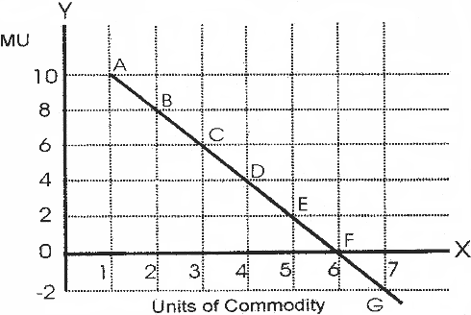
Law of Diminishing Marginal Utility

Slide 6
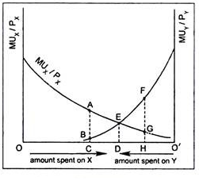
Law of Equi-marginal Utility
The equi-marginal principle is based on the law of diminishing marginal utility. The equi-marginal principle states that a consumer will be maximizing his total utility when he allocates his fixed money income in such a manner that the utility derived from the last unit of money spent on each good is equal.
The condition for a consumer to maximize utility is usually written in the following form:
MU_{X}/P_{X} = MU_{Y}/P_{Y}
So long as MU_{Y}/P_{Y} is higher than MU_{X}/P_{X}, the consumer will go on substituting Y for X until the marginal utilities of both X and Y are equalized.

Slide 7
References:
https://www.oreilly.com/library/view/managerial-economics/9788131775622/xhtml/chapter005.xhtml#:~:text=In%20Marshall's%20theory%2C%20the%20concept,different%20units%20of%20a%20good.
https://www.geeksforgeeks.org/diminishing-marginal-utility-meaning-assumptions-and-example/
https://www.managedstudy.com/micro/law_of_diminishing_marginal_utility.htm
https://www.economicsdiscussion.net/law-of-equi-marginal-utility-2/law-of-equi-marginal-utility-with-diagrams/16730#post/0

Slide 8
Thank You

